Slide 1

(DAT501) Sociology: Theory and Methods
Week 1: Introduction
Amine Sijilmassi
amine.sijilmassi@um6p.ma

Slide 2
PART 1: Practical details

Slide 3
Course principles
1. « Social sciences »
2. No distinction between theory and methods
3. Not a list of theories and methods
4. Thinking like a social scientist is a skill
5. What matters is what you implement
Notes:
This means, in this course, you will not have a lot lectures. Rather, you will work a lot on personal projects. I’m starting with this point because I suspect that this is the point that will be most unusual, and perhaps frustrating to you; because you will have to learn a lot by yourself. Don’t expect a class where you just learn your lesson and apply it. A lot of your time will be devoted to solve problems on your own.
This means that in this course you’ll get a lot of freedom to choose what you want to work on, what kind of data, and what techniques you want to use
This one is very important. The ability to ask good, relevant and precise questions, and to communicate results effectively, is as important as writing a good program
Related to ths point above, ultimately data analysis is a tool: the most complex tools are not necessarily the best; what matters is that the analysis we do helps us answer the question

Slide 4
Syllabus
https://github.com/aminelasso/SOC501-2026

Slide 5
Organization of the class
In class
(5 minutes) short quizz on Canvas on class material from the previous week
(~30 minutes) Lecture (or student presentations)
(1h30-2h30) TD on a specific example
At home
Mandatory readings
Add one observation in the weekly journal

Slide 6
Evaluation
(20%) Final essay (50 % written, 50 % oral)
(30%) Midterms: 2-hour analysis of a paper
(40%) Final exam: 3-hour analysis of a paper
(10%) Participation & attendance (1/3 Class exercises ; 1/3 short tests ; 1/3 Weekly Journal )

Slide 7
FOR NEXT WEEK:
Mandatory reading (see Syllabus)
First addition to the « Weekly Journal »
Choose the topic of your final essay

Slide 8
PART 2: What is social science?

Slide 9
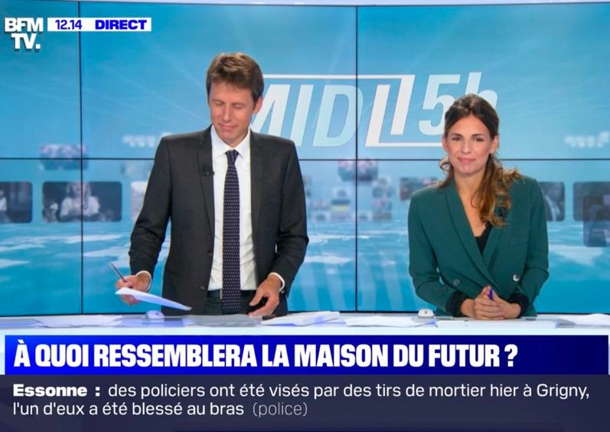

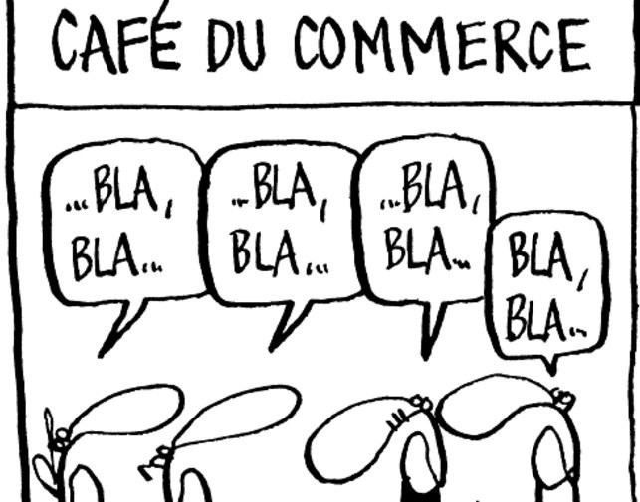
What does it mean to do social science?
as opposed to just “talking about society”?
Everyone talks about society

Slide 10
Social science wants to talk about society in a « disciplined » way
(or « scientific »)

Slide 11


The scientific method
1964
1970

Slide 12
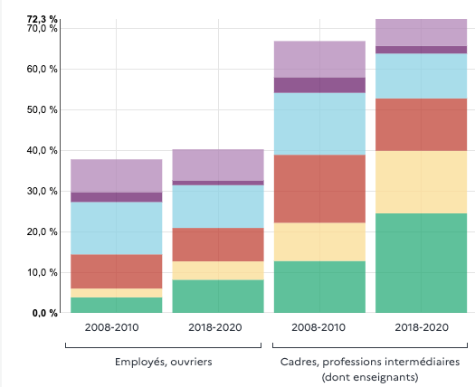
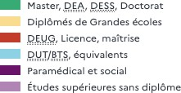
The scientific method

Slide 13
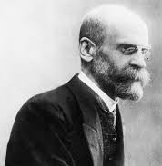
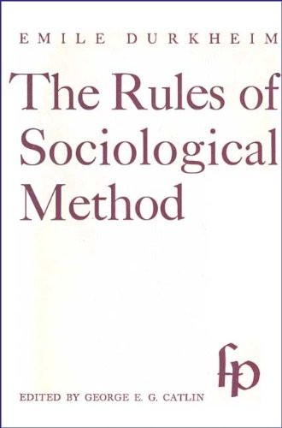
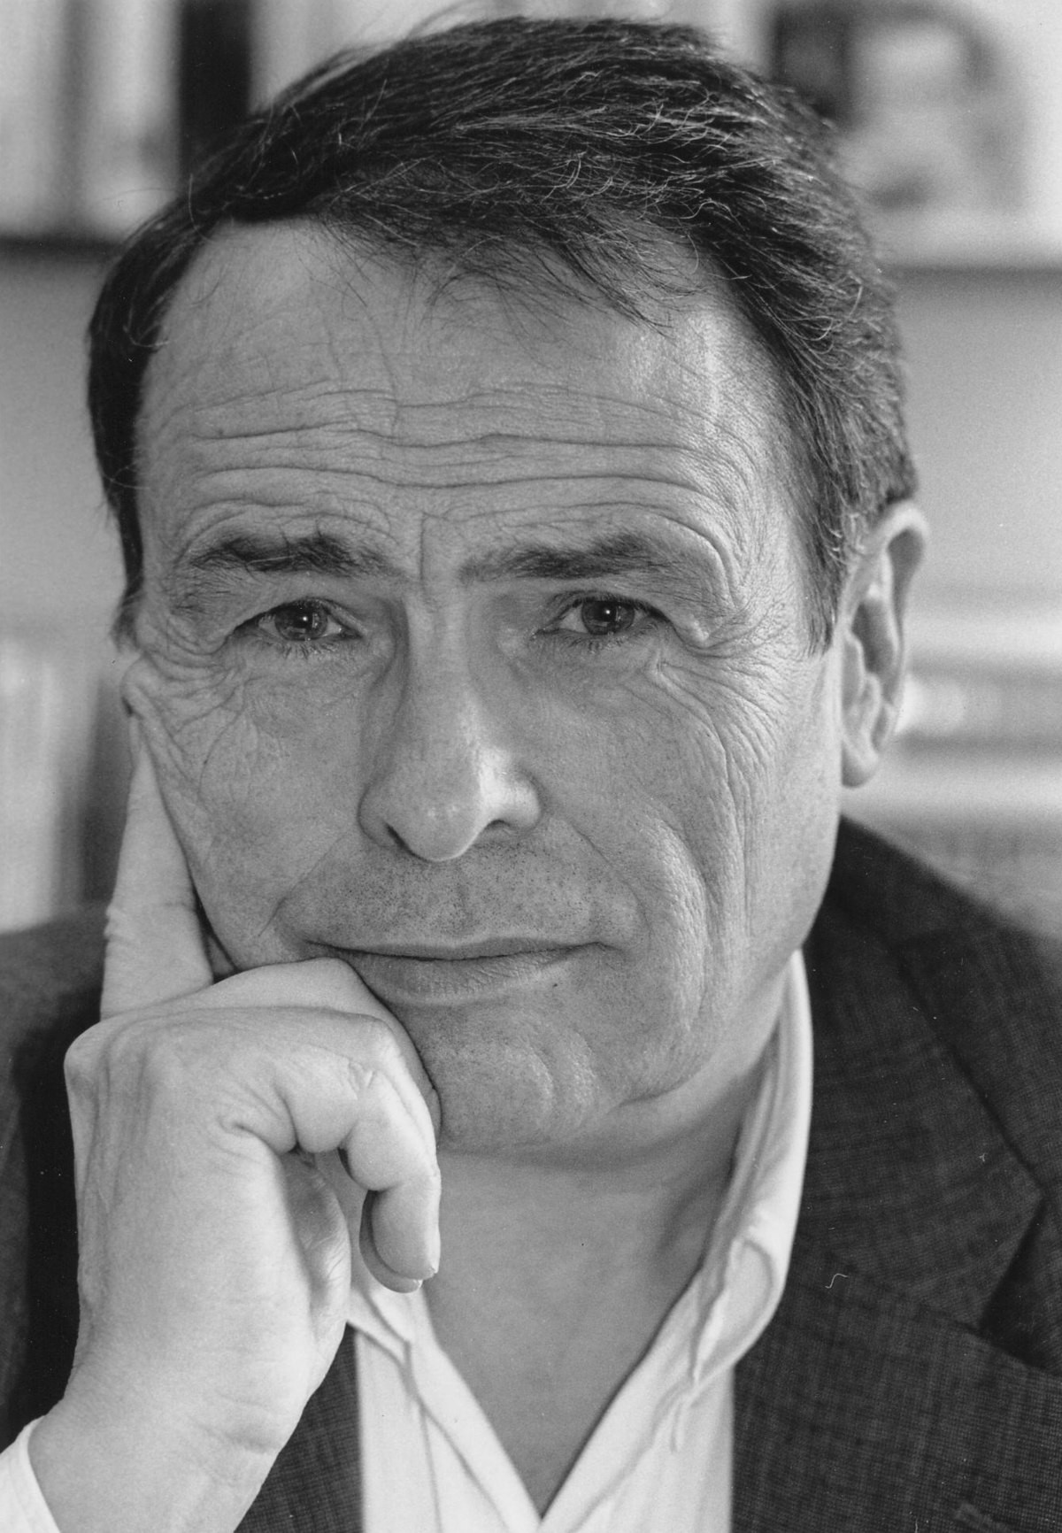

Ignoring “folk-theories”
A specific problem with social science is that everyone has intuitions or “folk- theories” about how society works
(e.g. about why people behave the way they do, why different social groups behave differently, how political institutions work, etc.)
Emile Durkheim
(founder of French sociology)
getting rid of “prenotions” to establish
objective facts
1894
Pierre Bourdieu
196
“sociologies spontanées”

Slide 14
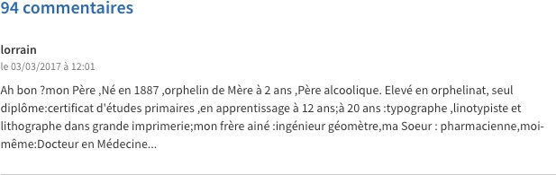
Ignoring “folk-theories”
A specific problem with social science is that everyone has intuitions or “folk- theories” about how society works
(e.g. about why people behave the way they do, why different social groups behave differently, how political institutions work, etc.)
Systematic data
Folk-theories based on personal anecdote

Slide 15
Ignoring “folk-theories”
The scientific study of social phenomena must begin with a departure from these “folk-theories” about how society works

Slide 16
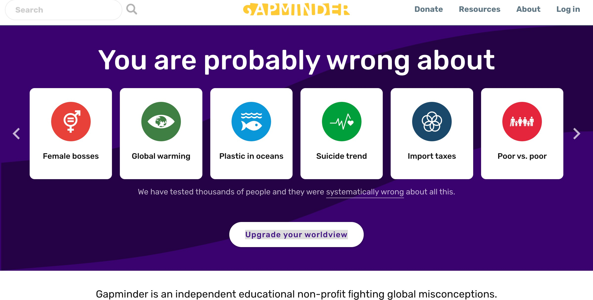
Science can yield counter-intuitive results
https://www.gapminder.org/

Slide 17
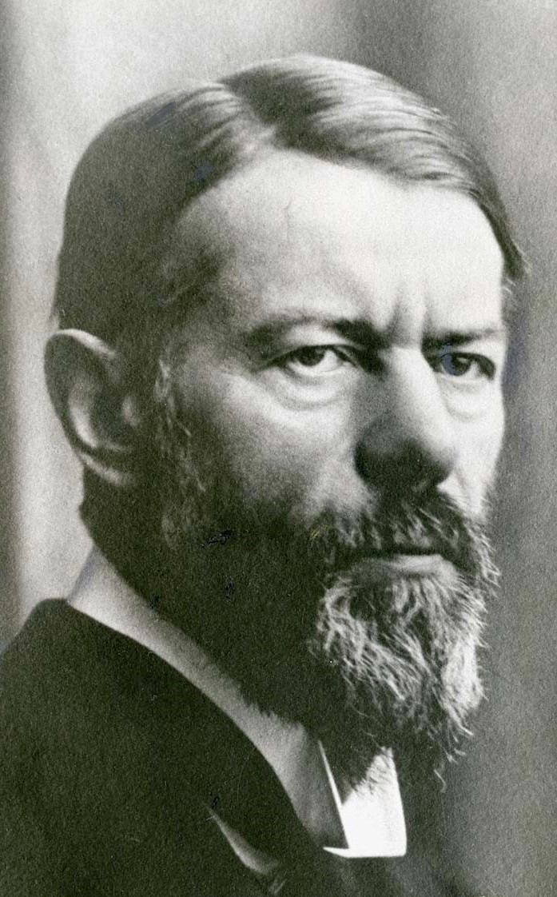
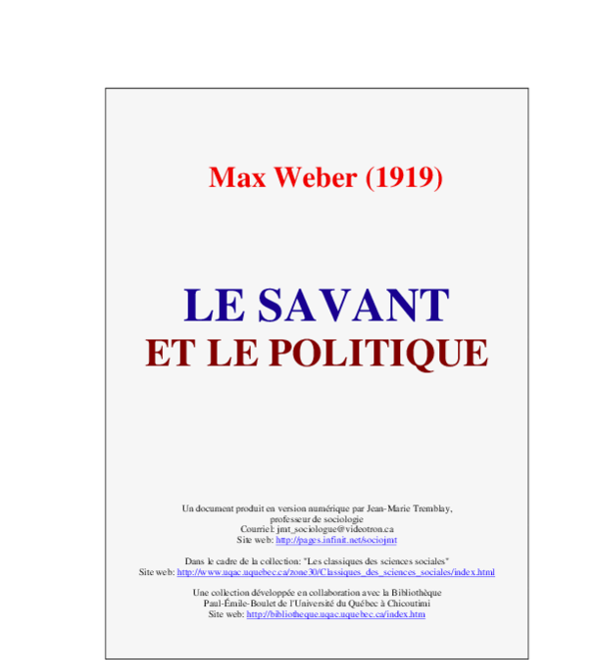
Axiologic neutrality
Axiologic neutrality = a methodological posture which aims at making the researcher aware of his own values during his scientific work, in order to reduce as much as possible the biases that his own value judgments could cause in his research
Max Weber
(German founder of sociology)
One should “treat social facts as things” (the word is from Durkheim)
This can be especially difficult when doing social sciences, because we’re talking about human phenomena that instinctively trigger value judgements (e.g. poverty, sexuality, politics)

Slide 18
Descriptive claims ≠ Normative claims
A descriptive claim is a claim that asserts that “X” IS the case.
➡Example: The distribution of wealth in society is X
A normative is a claim (or “prescriptive” claim) asserts that “X” OUGHT to be the case.
➡Example: The distribution of wealth in society is unjust and should be changed
Social science — just as sciences more broadly — only aims at producing true descriptions of what is — not moral judgements about what should be
(Weber, 1919)

Slide 19
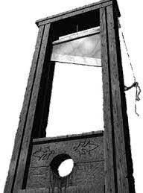
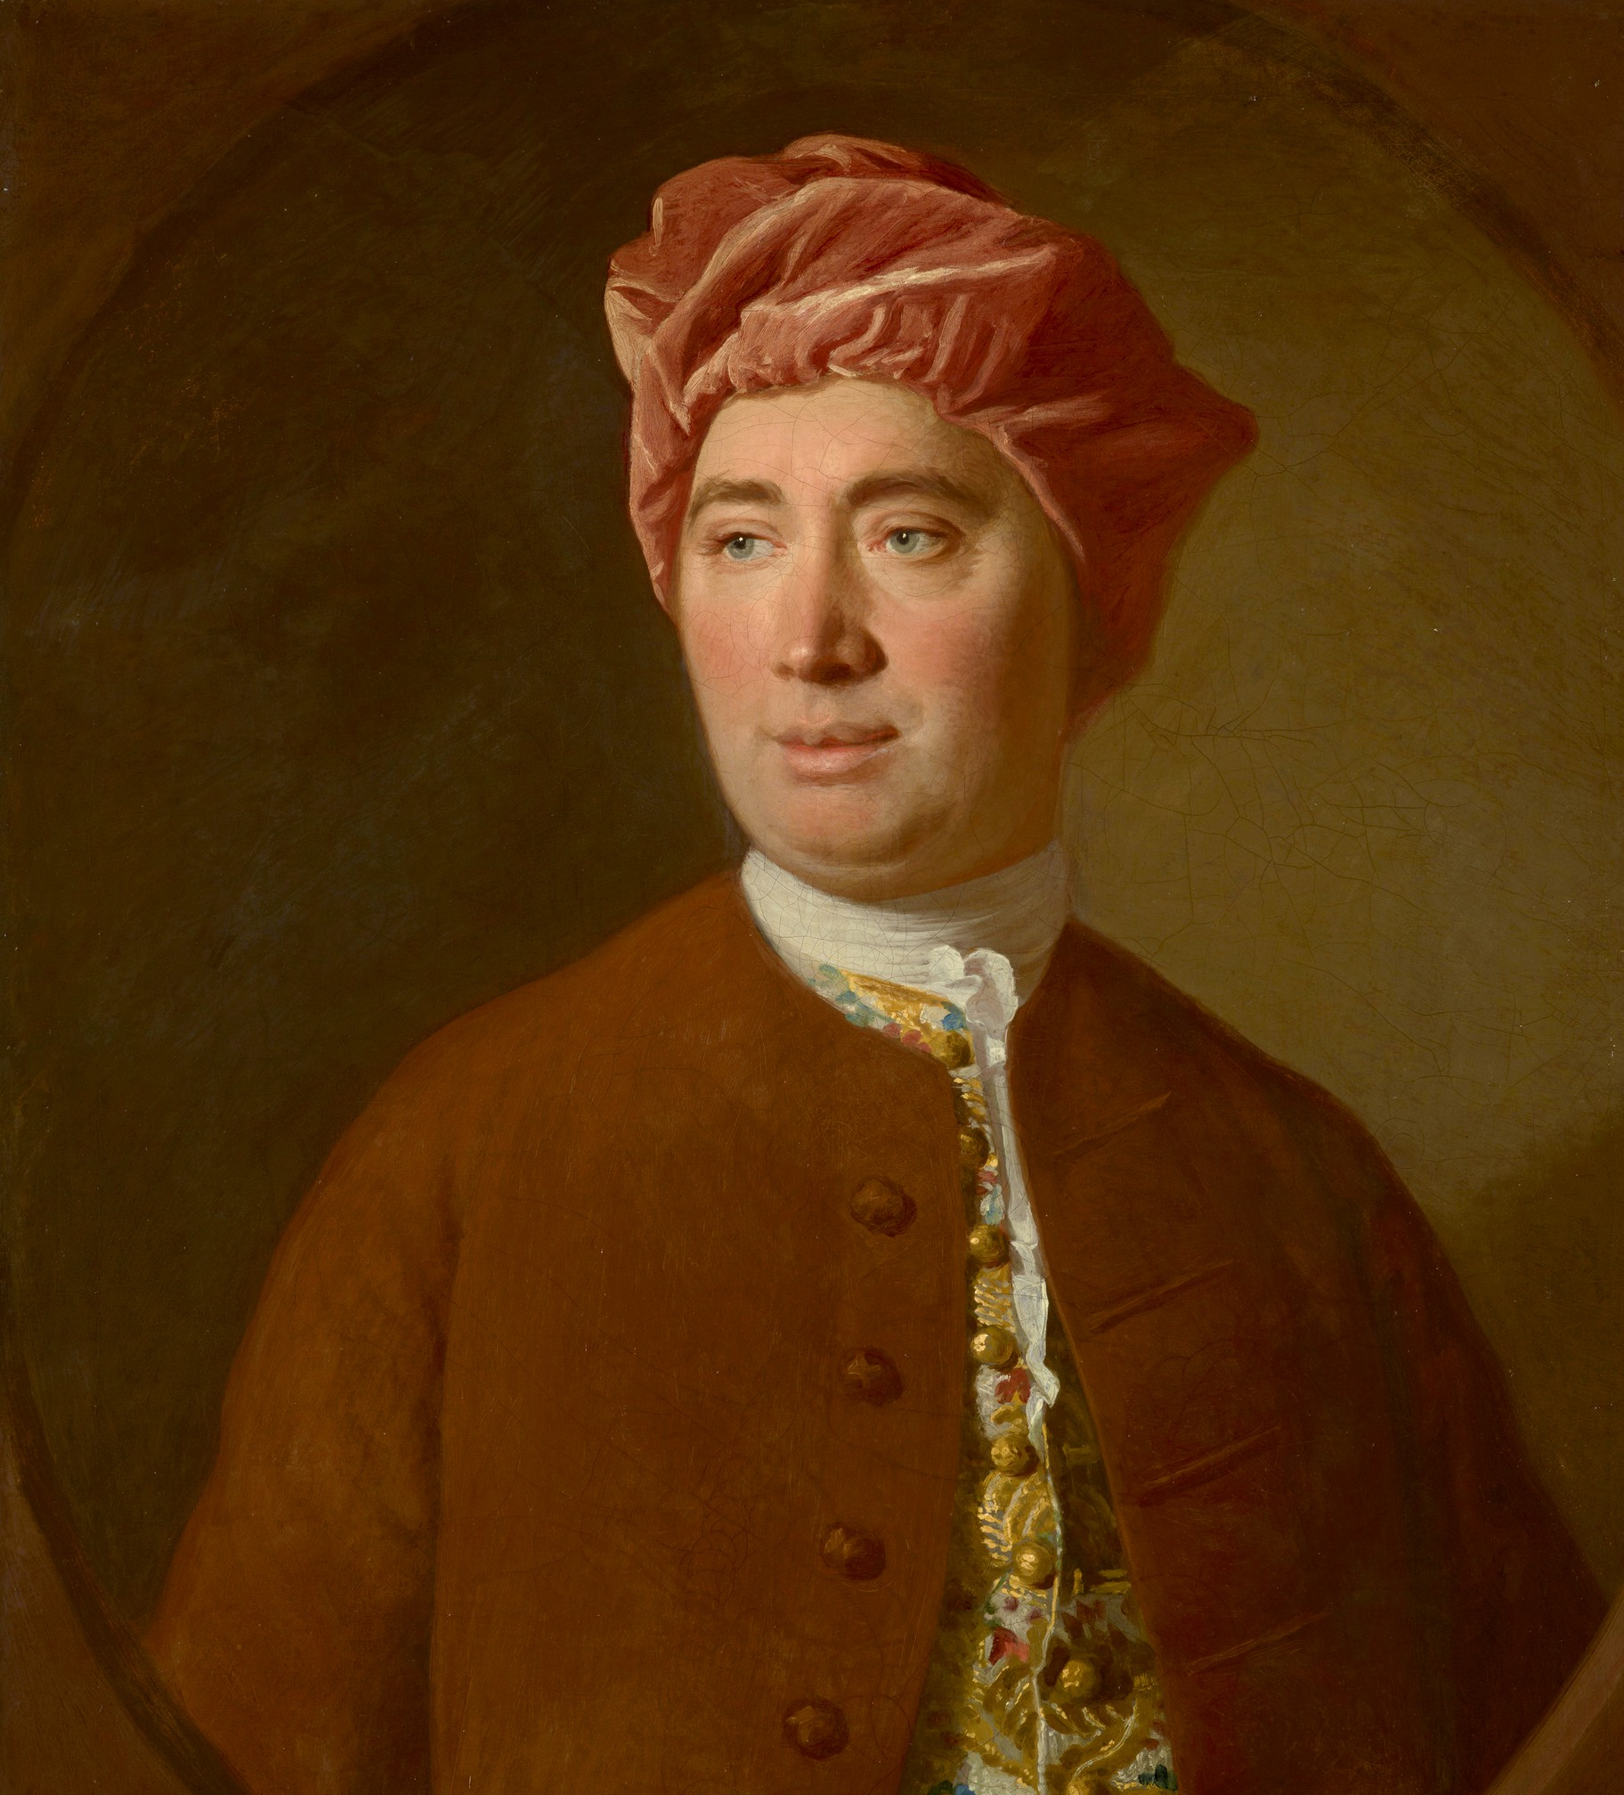
Descriptive claims ≠ Normative claims
“Hume’s Guillotine” = the idea that one cannot logically derive a normative claim from a descriptive claim
The fact that something is the case
doesn’t imply that it should be
Example: The fact that the distribution of wealth is X in society doesn’t tell us whether it’s just or morally right to have such a wealth distribution
Example: Social scientists can say “given what we know about how society works, implementing policy X will cause Y”
But this doesn’t tell us whether we should desire or value Y
David Hume
(Scottish philosopher, 18th century)
A Treatise of Human Nature (1739)

Slide 20
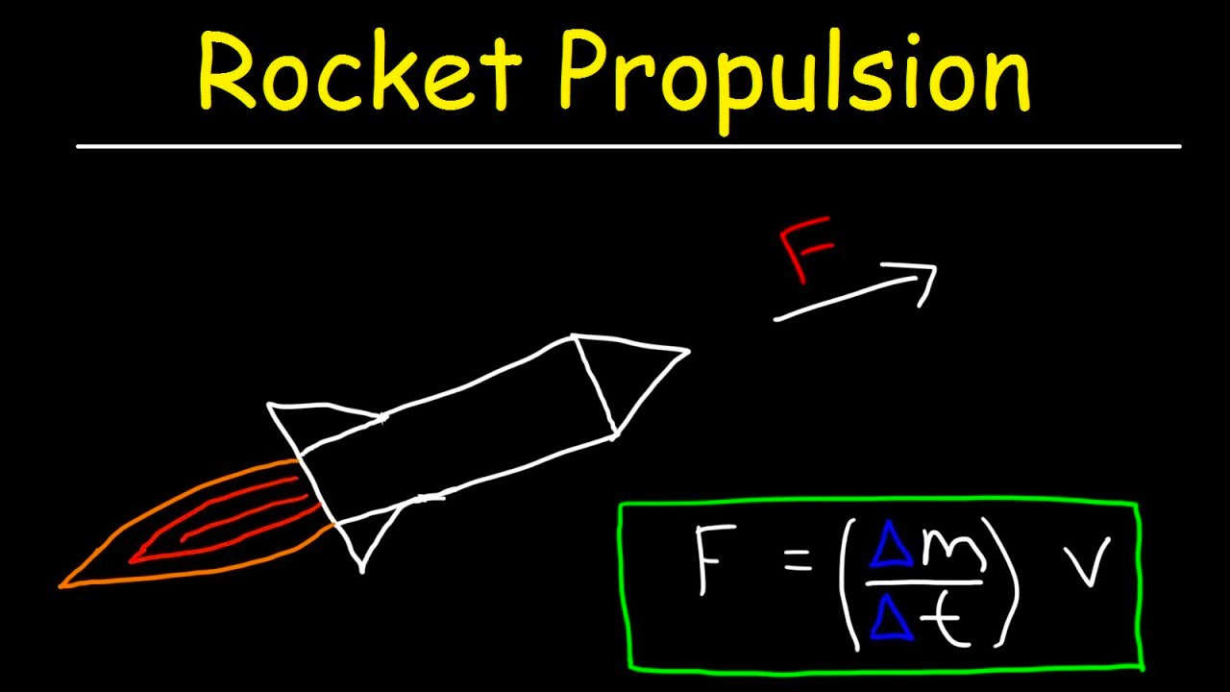
Descriptive claims ≠ Normative claims
The laws of rocket propulsions doesn’t tell you whether it is legitimate that governments invest public money in spatial exploration
Take the analogy with physics…

Slide 21
Methods in social science
There are 3 main methods in social sciences
  Quantitative methods: you count and measure stuff (ex: a study to show that school performance is related to parental income)
  Qualitative methods: you observe social phenomenon without counting or measuring (ex: an ethnography of schools in low income areas)
  Modelling methods: you use mathematical tools to model behavior and make predictions (ex: a mathematical model of how people make decisions to invest in their education

Slide 22
Quantitative methods
Descriptive/Correlational methods
Causal inference

Slide 23


Quantitative methods
A. Descriptive methods
Definition: Methods that simply describe how the world is
Surveys & questionnaires (ex: in France, Insee)
Exploiting existing data that was not collcted for research purposes (ex: administrative data, online data...)

Slide 24
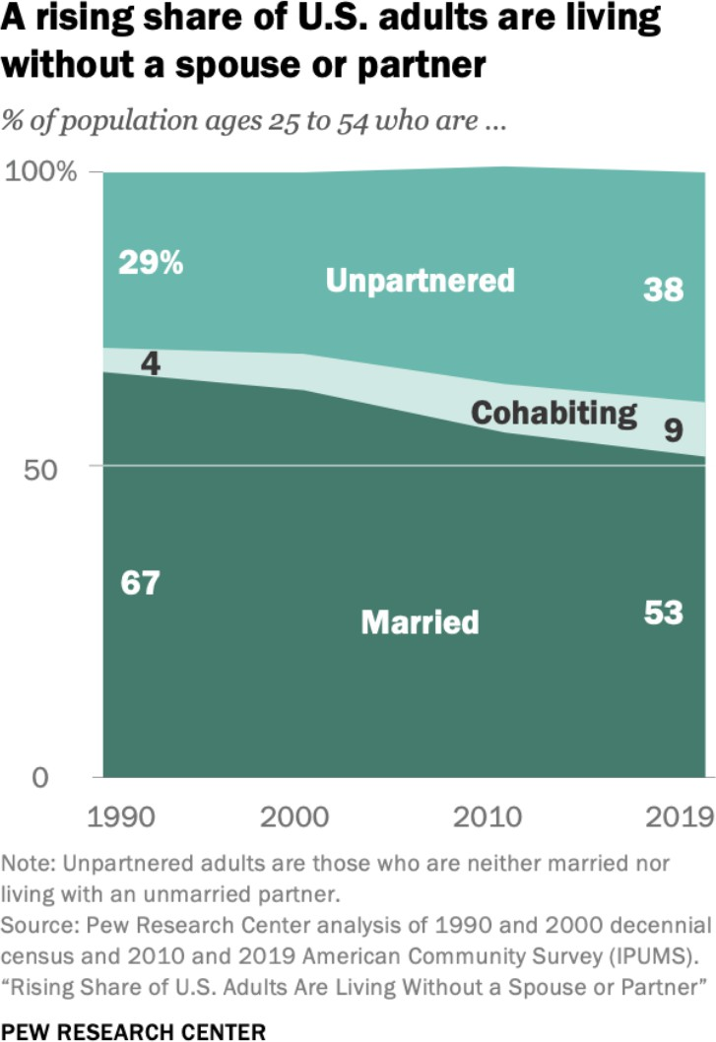
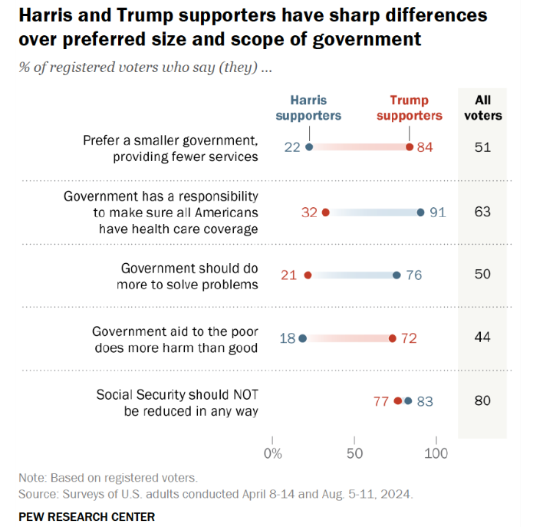
Example of descriptive survey data:
https://www.pewresearch.org/social-trends/2021/10/05/rising-share-of-u-s-adults-are-living- without-a-spouse-or-partner/pst_10-05-21_unpartnered_adults-0-0/
https://www.pewresearch.org/politics/2024/08/26/the-political-values-of-harris-and-trump-supporters/

Slide 25
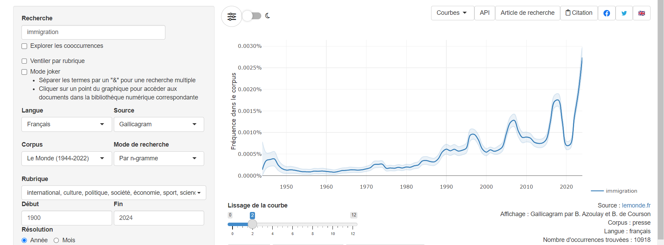
« Anything » can become data:
Ex: Gallicagram (https://shiny.ens-paris-saclay.fr/app/gallicagram)

Slide 26



Quantitative methods
Interesting survey data resources:
International survey databases (World Value Survey, etc)
Government statistics agencies
Private poll agencies

Slide 27
Quantitative methods
The most common type of descriptive method is to observe correlations (= the linear relationship between two variables)

Slide 28
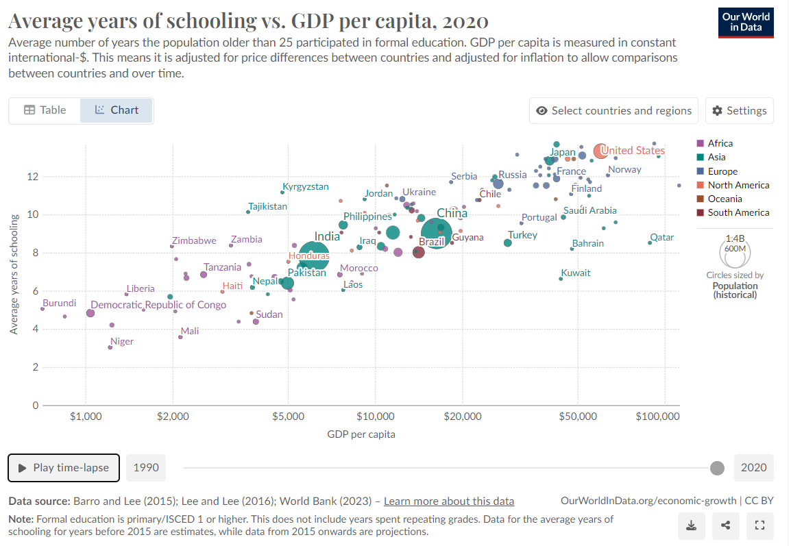
https://ourworldindata.org/grapher/average-years-of-schooling-vs-gdp-per-capita?time=2020

Slide 29
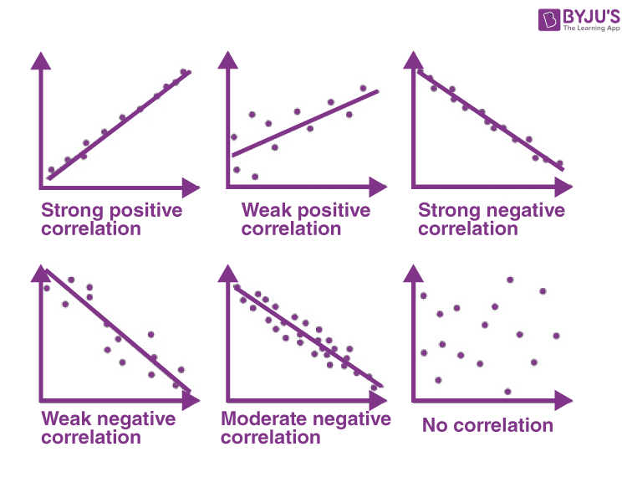

Slide 30
Problem 1: What is the direction of causality? (does education create economic prosperity or the opposite?)
Problem 2: What if there are hidden variables at play? (maybe it's something else, like better health, that both increases education and economic prosperity!)
Correlation is not causation

Slide 31
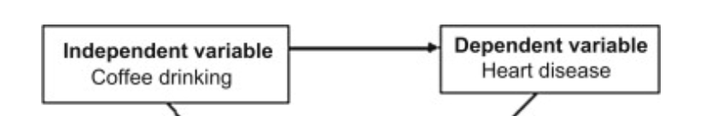
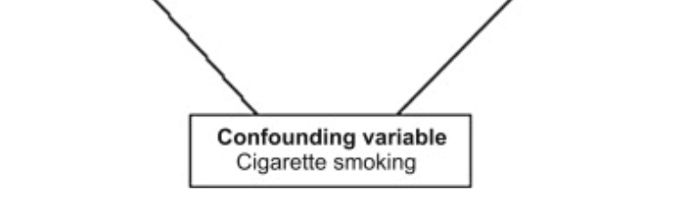

Slide 32
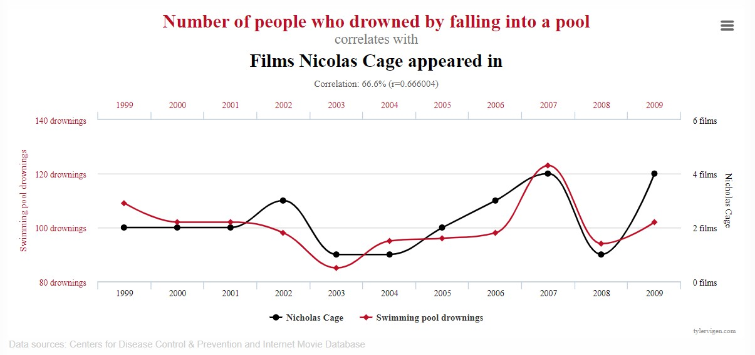
Problem: descriptive data says little about causality
We need more than just crude numbers to establish causal relationships
https://www.tylervigen.com/spurious-correlations

Slide 33
Quantitative methods
B. Causal inference: the experimental method
Definition: Methods that do not simply describe how the world is, but seek to explain it, by establishing causal relationships
The gold standard of causal inference is the experimental method

Slide 34
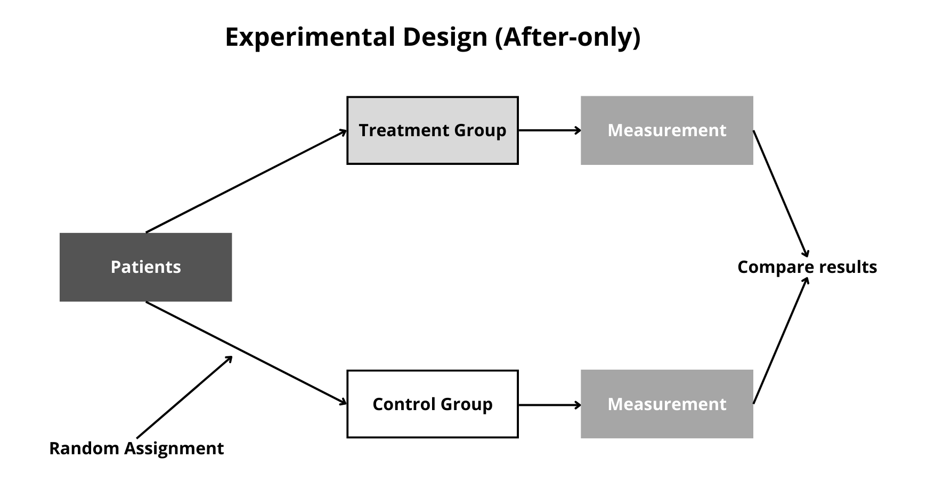
Quantitative methods
B. Causal inference: the experimental method

Slide 35
Quantitative methods
Pros:
  Systematic evidence (not just based on anecdotes)
  Can allow causal inference
Cons:
  Some things are difficult to measure (emotions, shameful or illegal behavior...)
  Data is not always available

Slide 36


Qualitative methods
Methods that collect non-numerical data
Interviews:
Observation (participant or non-participant):

Slide 37
Qualitative methods
Pros:
  Fine-grained, "thick" descriptions (while quant data can be a bit "dry")
  Can give insights that are not captured by quantitative data
Cons:
  Difficult to generalize findings
  Difficult to establish causal relationships

Slide 38
Mathematical Models
Definition: A description of social processes with mathematics
1. Propose a set of variables
2. Make hypotheses about how these variables are mathematically related
3. Make predictions based on these hypotheses

Slide 39
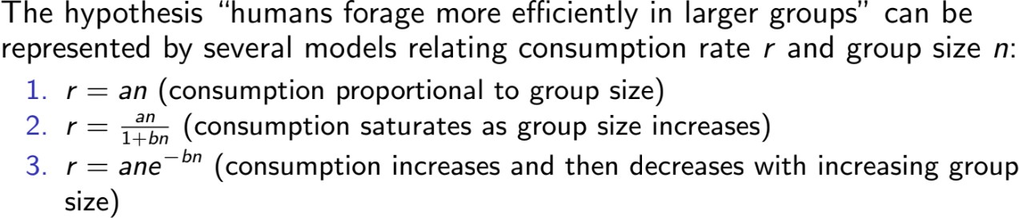
Mathematical Models
Ex: imagine you want to build a theory about how group size impacts group productivity
*In this context, forage = "work together"

Slide 40
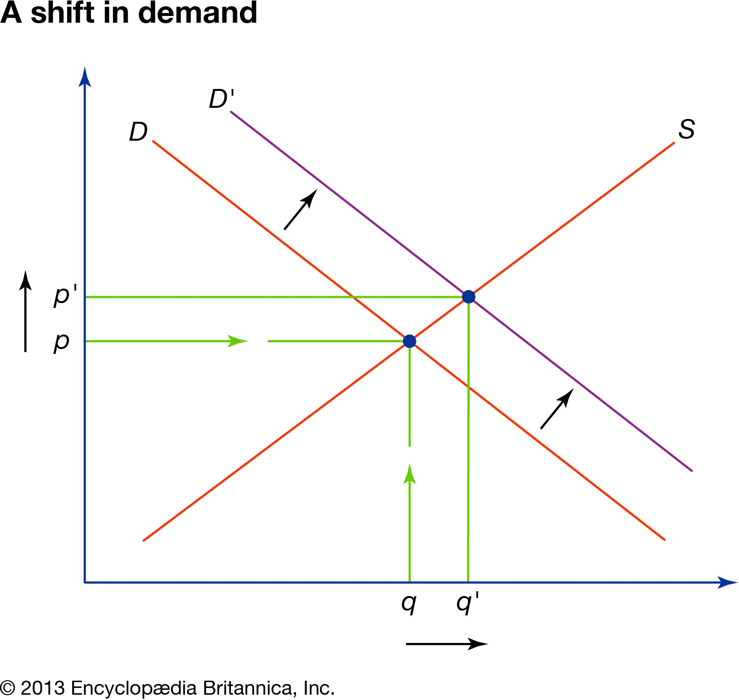
Mathematical Models
The most famous economic model

Slide 41
Mathematical Models
Pros:
  Forces you to be clear about your assumptions and mechanisms
  Allows you to make clear predictions (you don't just observe, you know what will happen if group size increases or if there's a shock in demand)
Cons:
  Often requires to (over-)simplify reality (is it a problem?)
  If the assumptions are bad the model is bad (not really a problem either)

Slide 42
These methods are used in all disciplines, but each discipline has more predominant approaches
Sociology
  Mix of descriptive statistics and qualitative work + some causal inference
Political Science
  Mix of causal inference and qualitative work + some mathematical modeling
Economics
  Mix of causal inference and mathematical modeling, but increasingly experimental
Anthropology
  Known for participant observation (ethnographies), but increasingly quantitative
Psychology
  Known for experimental methods

Slide 43
Theoretical paradigms in social sciences
A theoretical paradigm = a set of core hypotheses about how human behaviour and society work in general, on the basis of which we can generate hypotheses to explain some particular phenomena
There is no unified paradigm in social science.
It is common to distinguish two broad ‘families’ of paradigms (although the distinction is somewhat artificial!)
“Individualistic” or “agentic approaches”
  “Holistic” or “culturalist” approaches

Slide 44
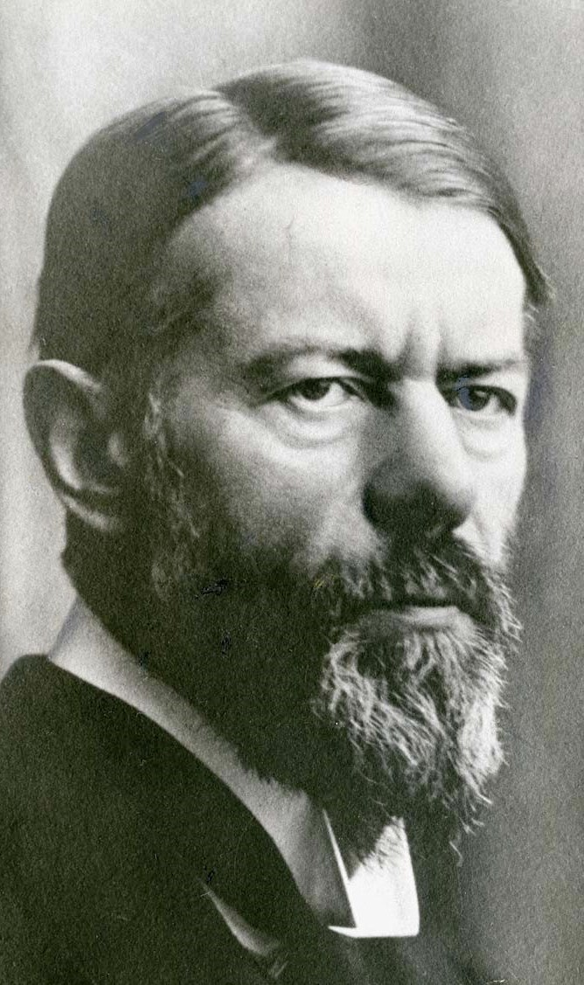
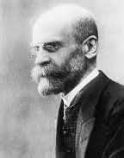


It is common to distinguish two broad ‘families’ of paradigms (although the distinction is somewhat artificial!)
“Individualism”
“Holism”
Collective phenomena
Collective phenomena
Institutions
Values
Institutions
Values
Beliefs
Norms
Beliefs
Norms
Emile Durkheim
Max Weber
Explain
Explains
Individual behavior
Individual behavior

Slide 45
A typical individualist or (“agentic”) paradigm: Rational Choice Theory
One of the most popular and successful paradigm: predominant in economics, influential in political science and part of sociology.
Main idea: individuals make rational decisions by analyzing the costs and benefits of every available option.
To make rational decisions, individuals/agents use:
  the information they have — about the different options they have and their respective costs and benefits
their preferences: the relative value they ascribe to different objects (e.g., I prefer apples to pears). Most preferred options bring you more utility (= satisfaction, well-being…)

Slide 46
Rational Choice Theory
Assumptions:
Individuals are instrumentally rational: they act in a way that maximizes their satisfaction given the information and preferences they have
  Individuals' preferences are selfish: they act in a way that maximizes their own personal satisfaction, given what information and what preferences they have
Why is RCT so successful?
Allows us to build models: simplified descriptions of complex phenomena
Models allow us to make predictions (if X happens, Y will happen)
It has been highly successful in describing many social behavior (e.g., economic behavior, but also more "social" decisions like crime, education, founding a family...)

Slide 47
Rational Choice Theory
Bad critiques:
"RCT is obviously wrong because people are not selfish (they help their friends, families, volunteer...)"
=> Some RCT models explain that you can have an interest in helping others even when you are selfish
=> Increasingly, RCT models introduce altruistic preferences (= you can get satisfaction from helping others)
"RCT is obviously wrong because humans are social animals: they obey to social norms, conformism, etc...
=> Increasingly, RCT models introduce social norms preferences (= you can get satisfaction from following the norms of your group)
"RCT is obviously wrong because people are not rational - in fact they are rather stupid"
=> When you investigate a behavior deeply (even weird behaviors) you often realize the underlying rational logic (given information and preferences)

Slide 48
Rational Choice Theory (RCT)
Good critiques:
RCT researchers make assumptions about people's preferences. But where do these preferences come from?
Why do preferences seem often so irrational and stupid? For example: eating salt and fat that makes us sick, smoking cigarettes, driving drunk...?
  Individuals are selfish ( = they only care about their own satisfaction)
RCT is not perfect, but it works pretty well!

Slide 49

A typically holistic paradigm: Durkheimian social facts
Individual
Culture of the
group/society
Interiorized values, norms, preferences, habits, etc.
Values, norms, beliefs, preferences, habits, tools, etc.
Socialization
Cognitive
mechanisms for
Behavior

Slide 50
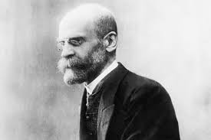
A typically holistic paradigm: Durkheimian social facts
Les Règles de la méthode sociologique (1894)
Sociology is the science of “social facts”:
Social facts = “manières d’agir, de penser et de sentir, qui sont extérieures à l’individu, et qui sont dotées d’un pouvoir de coercition en vertu du quel elles s’imposent à lui”
Example: Eating with a fork instead of your hands

Slide 51

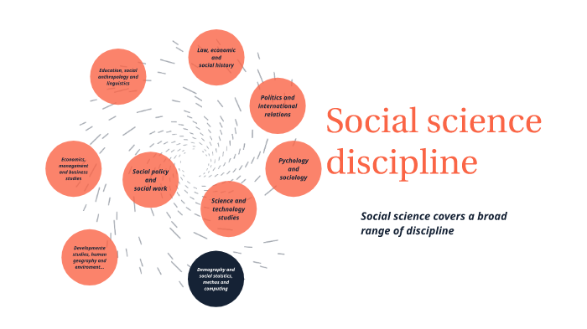
What truly matters in social science is the paradigm: it’s the real « engine », the rest is superficial
By discipline
By object (or area)

Slide 52


Slide 53
PART 3: What do social scientists do?

Slide 54
I) Skill 1: Sociological wonder
A) Historical comparison
B) Cross-cultural comparison (anthropology)
C) Critical sociology and « dévoilement »
II) Skill 2: See the social everywhere
A) The paradigmatic case: suicide
B) Sociology of the body (sociologie du corps)
C) Sociology of cultural taste
III) Skill 3: Paradigm Imperialism
A) What is a paradigm
B) What is paradigm imperialism?
IV) Debunking folk-theories

Slide 55
I) Skill 1: Sociological wonder
A) Historical comparison
B) Cross-cultural comparison (anthropology)
C) Critical sociology and « dévoilement »

Slide 56

Thinking like a social scientist is a skill
Becker, H. S. (1998). Tricks of the trade: How to think about your research while you're doing it. University of Chicago Press.

Slide 57




Workshop 1
Why do we face the door when waiting in the elevator?
Why was it normal for men to hold hands in the past but less now?
Why are chairs only found in industrial societies?
Why is witchcraft universal?
1: Why is it puzzling?
2: Propose various explanations and think about their underlying assumptions
3: Think about « predictions » (if my explanation is true, what should I observe in the world?)

Slide 58
Skill 1: « Sociological wonder »
The capacity to be puzzled by society

Slide 59
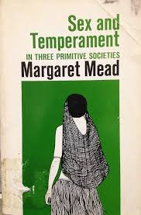


Skill 1: « Sociological wonder »
The capacity to be puzzled by society
Pierre Bourdieu: « sociologie du dévoilement »
Norbert Elias: « Civilization process »
Margaret Mead: the variability of gender roles

Slide 60
I) Skill 1: Sociological wonder
A) Historical comparison
B) Cross-cultural comparison (anthropology)
C) Critical sociology and « dévoilement »

Slide 61

Major historiographic movements in the 20th century
« Ecole des Annales »: a historiographic school of thought born in the 1920s advocating for a holistic, interdisciplinary (esp. economics, sociology, anthropology) and « longue durée » approach to history; not just political and military history: Fernand Braudel; Marc Bloch; Lucien Febvre….

Slide 62


Major historiographic movements in the 20th century
1960s: « histoire des mentalités »; an offshoot of Ecole des Annales, focusing on trying to understand a time’s « mentalité »
Later: « histoire des représentations », « histoire des sensibilités », « histoire culturelle »; « cultural history » in the English-speaking world…
La civilisation de l'Occident médiéval, Paris, Arthaud, 1964
La Naissance du purgatoire, Paris, Gallimard, 1981

Slide 63

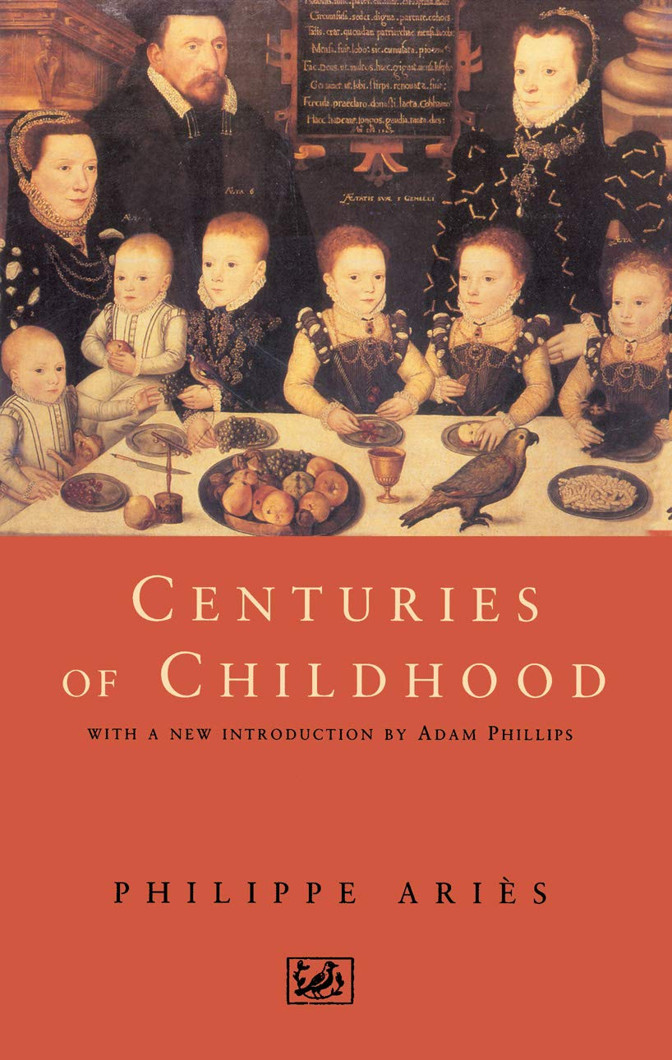
Sociological wonder through history
What this literature contributed: « historicize » facts that seem natural to us!
Example: the work of the historian Philippe Ariès
« Childhood » is a historical construction: before the 15th century in Europe, there wasn’t a concept of a separate stage of life called childhood distinct from adulthood
Children were « small adults »: but shared the same clothes, games, responsibilities, and were not seen in this ultra protective lens

Slide 64
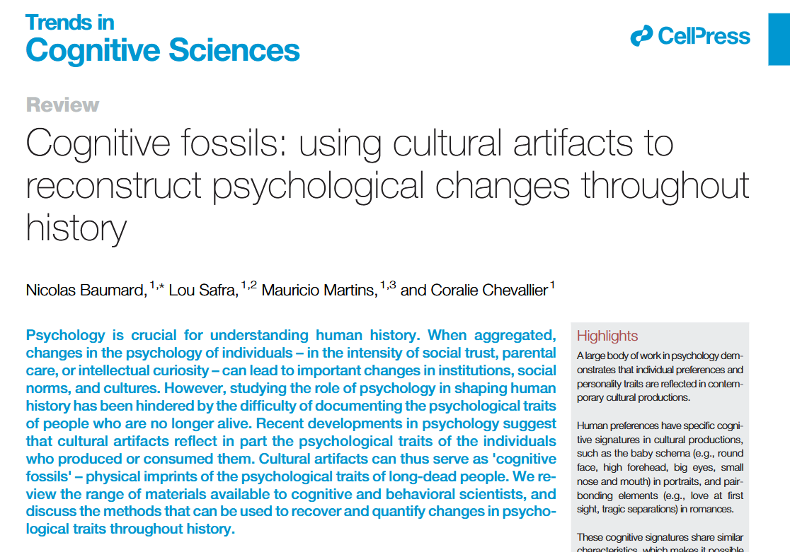
Baumard, N., Safra, L., Martins, M., & Chevallier, C. (2024). Cognitive fossils: using cultural artifacts to reconstruct psychological changes throughout history. Trends in Cognitive Sciences, 28(2), 172-186.

Slide 65



Sociological wonder through history
« Homosexuality » as a distinct identity and strictly codified classification is recent (and Western)
El-Rouayheb, K. (2005). Before homosexuality in the Arab-Islamic world, 1500-1800 (Paperback edition). University of Chicago Press.
Ibson, J. (2002). Picturing men : a century of male relationships in everyday American photography. University of Chicago Press.
Foucault, M. (1976). Histoire de la sexualité, I: La volonté de savoir

Slide 66
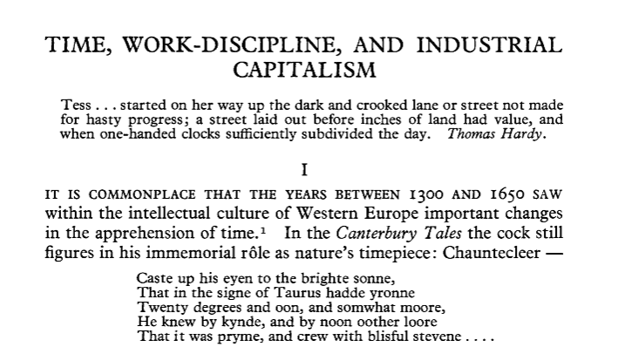
Sociological wonder through history
Ideas about time that seem natural to us (e.g. the work/free time distinction; the idea of time being tied to currency; as in wage per hour; the whole apparatus of time devices: clocks, timesheets, calendars; the ethic of time discipline and punctuality…)… are in fact modern constructions in the West
They have to do with economic shifts (here: a typical Marxist, materialist, economicist explanation)
Thompson, E. P. (1967). Time, work-discipline, and industrial capitalism. Past & Present, 38(1), 56–97.

Slide 67
When studying a social science object, it’s always a good thing to read about its history over the « long durée »

Slide 68
I) Skill 1: Sociological wonder
A) Historical comparison
B) Cross-cultural comparison (anthropology)
C) Critical sociology and « dévoilement »

Slide 69
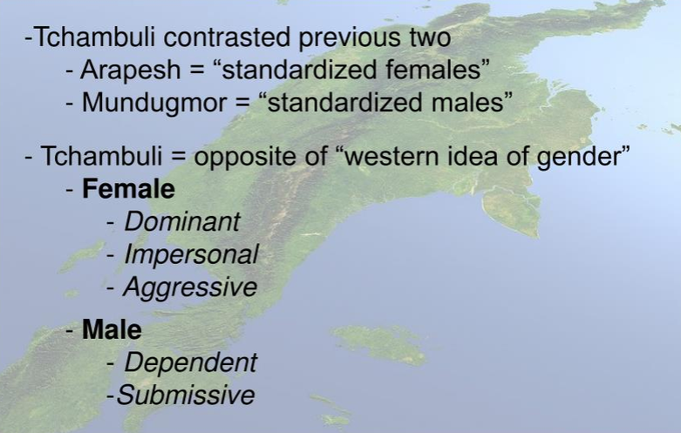
Sociological wonder through anthropology
In an participant observation in three New Guinea small-scale societies, Mead observed striking differences in gender norms
Mead, M. (1935). Sex and temperament in three primitive societies. William Morrow.

Slide 70
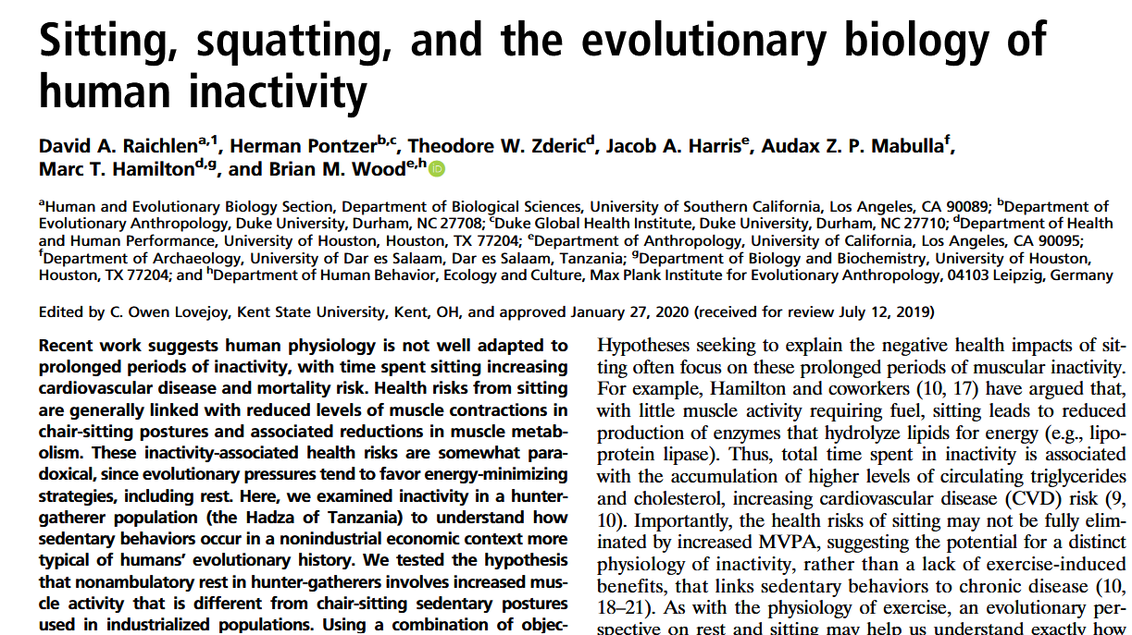

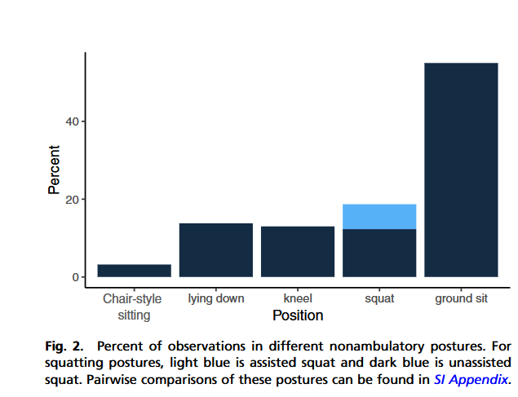
Raichlen, D. A., Pontzer, H., Zderic, T. W., Harris, J. A., Mabulla, A. Z. P., Hamilton, M. T., & Wood, B. M. (2020). Sitting, squatting, and the evolutionary biology of human inactivity. Proceedings of the National Academy of Sciences, 117(13), 7115–7121. https://doi.org/10.1073/pnas.1911868117

Slide 71

Difference between humans and closest apes…
Extensive prosociality with strangers
Cooperative breeding and low inter-breeding interval (IBI)
Fairness intuitions? Culture?

Slide 72
Workshop 2
Love
First names
Artistic taste
Disgust
This is a list of feelings or behavior that feel intimate, personal. Choose one, and take a few moments to think about whether they can be objects of social science. If so, propose ways in which you can study them.

Slide 73
Skill 2: « See the social everywhere »
The capacity to identify social patterns underlying apparently intimate, individual or isolated facts

Slide 74
II) Skill 2: See the social everywhere
A) The paradigmatic case: suicide
B) Sociology of the body (sociologie du corps)
C) Sociology of cultural taste

Slide 75

The social patterns behind suicide
Suicide, an intimate, psychological and taboo behavior… exhibits striking regularities and patterns!
Social patterns are what justify « sociology » as a discipline, in addition to psychology! Psychologists study suicide, sociologists study the « suicide rate »
Quantitative methods are historically central in social science!

Slide 76
II) Skill 2: See the social everywhere
A) The paradigmatic case: suicide
B) Sociology of the body (sociologie du corps)
C) Sociology of cultural taste

Slide 77
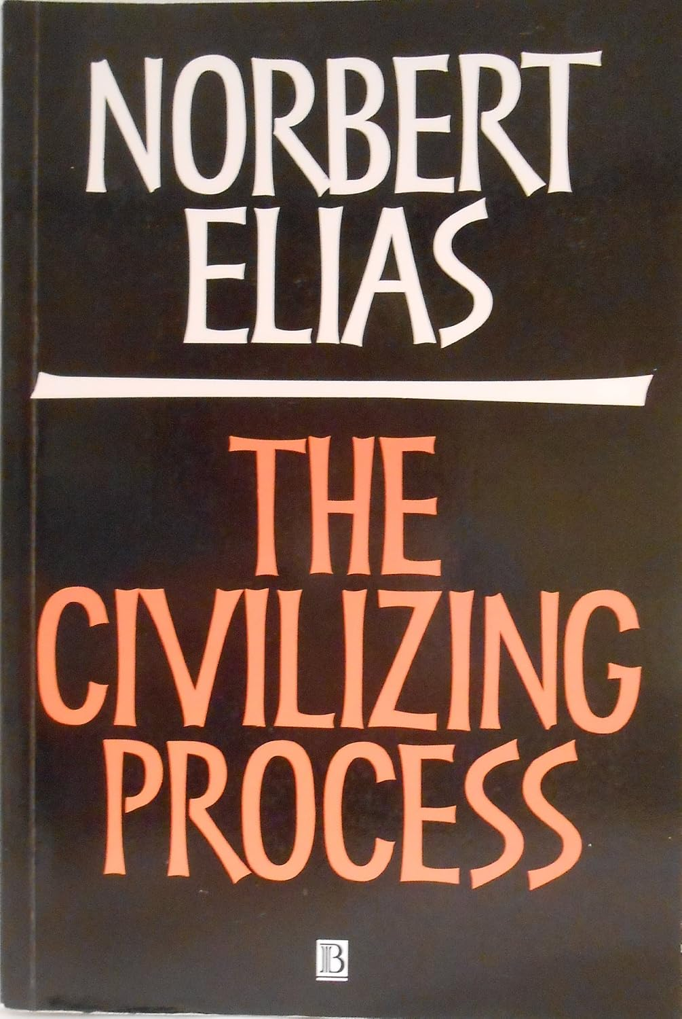
The social patterns behind bodily behavior and manners
Disgust feels biological, automatic, timeless, and triggered by specific behaviors: spitting, blowing your nose in your hand, eating from a shared dish, bodily functions
Elias studied etiquette manuals from the Middle Ages onward (16th century onwards)
Demonstrates a major transition from low self-restraint in behavior (e.g. it was normal to blow one’s nose in the tablecloth, spit under the table, exert bodily functions, be aggressive while eating…) to more “refinement” and self-restraint: using forks and plates, “behaving” at the table…
He links this to the mutations of the state and elites: as European kingdoms expanded and stabilized, warfare became less important; aristocrats spent more time in the court than in war, resulting in values that value restraint more and impulsitivity less
Elias, N. (2000). The civilizing process: Sociogenetic and psychogenetic investigations (E. Jephcott, Trans.; Rev. ed.). Blackwell. (Original work published 1939)

Slide 78
II) Skill 2: See the social everywhere
A) The paradigmatic case: suicide
B) Sociology of the body (sociologie du corps)
C) Sociology of cultural taste

Slide 79
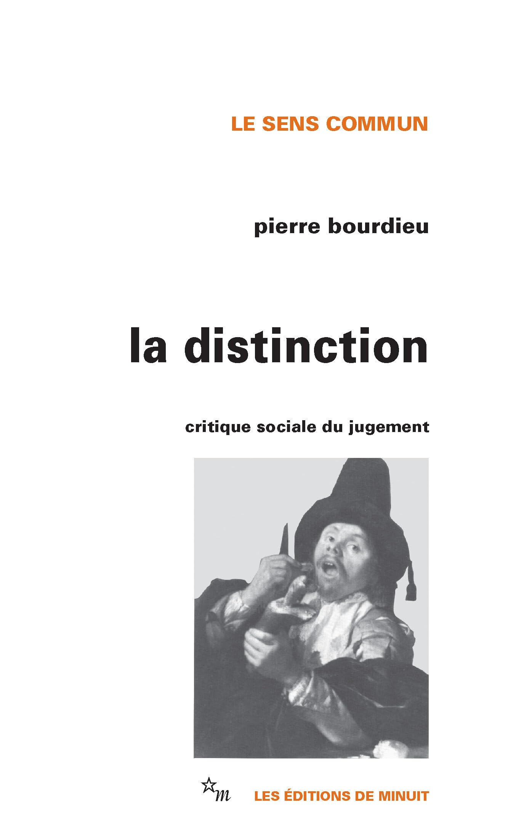
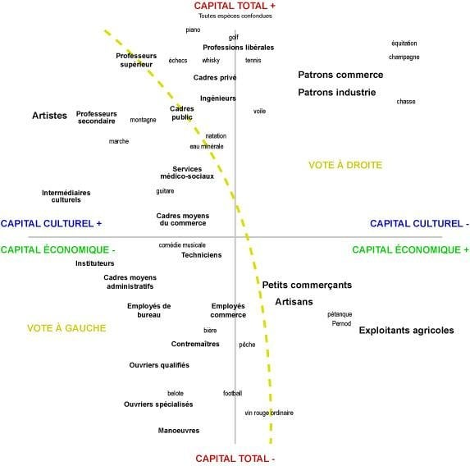
The social patterns behind tastes
According to Bourdieu, tastes are not individual, and they’re not about aesthetics: they are socially constructed, and act as social weapons for social reproduction
Bourdieu, P. (1979). La distinction: Critique sociale du jugement. Éditions de Minuit.

Slide 80
The social patterns behind tastes
According to Bourdieu, tastes are not individual, and they’re not about aesthetics: they are socially constructed, and act as social weapons for social reproduction
Tastes are formed early on as “habitus”: an embodied “second nature” by which we see and perceive the world
By acquiring the right taste, the dominant classes maintain and justify their domination
Bourdieu, P. (1979). La distinction: Critique sociale du jugement. Éditions de Minuit.

Slide 81
III) Skill 3: Paradigm Imperialism
A) What is a paradigm
B) What is paradigm imperialism?

Slide 82
Theoretical paradigms in social sciences
A theoretical paradigm = a set of core hypotheses about how human behaviour and society work in general, on the basis of which we can generate hypotheses to explain some particular phenomena
There is no unified paradigm in social science.
It is common to distinguish two broad ‘families’ of paradigms (although the distinction is somewhat artificial!)
“Individualistic” or “agentic approaches”
  “Holistic” or “culturalist” approaches

Slide 83
It is common to distinguish two broad ‘families’ of paradigms (although the distinction is somewhat artificial!)
“Individualism”
“Holism”
Collective phenomena
Collective phenomena
Institutions
Values
Institutions
Values
Beliefs
Norms
Beliefs
Norms
Emile Durkheim
Max Weber
Explain
Explains
Individual behavior
Individual behavior

Slide 84
A typical individualist or (“agentic”) paradigm: Rational Choice Theory
One of the most popular and successful paradigm: predominant in economics, influential in political science and part of sociology.
Main idea: individuals make rational decisions by analyzing the costs and benefits of every available option.
To make rational decisions, individuals/agents use:
  the information they have — about the different options they have and their respective costs and benefits
their preferences: the relative value they ascribe to different objects (e.g., I prefer apples to pears). Most preferred options bring you more utility (= satisfaction, well-being…)

Slide 85
Rational Choice Theory
Assumptions:
Individuals are instrumentally rational: they act in a way that maximizes their satisfaction given the information and preferences they have
  Individuals' preferences are selfish: they act in a way that maximizes their own personal satisfaction, given what information and what preferences they have
Why is RCT so successful?
Allows us to build models: simplified descriptions of complex phenomena
Models allow us to make predictions (if X happens, Y will happen)
It has been highly successful in describing many social behavior (e.g., economic behavior, but also more "social" decisions like crime, education, founding a family...)

Slide 86
Rational Choice Theory
Bad critiques:
"RCT is obviously wrong because people are not selfish (they help their friends, families, volunteer...)"
=> Some RCT models explain that you can have an interest in helping others even when you are selfish
=> Increasingly, RCT models introduce altruistic preferences (= you can get satisfaction from helping others)
"RCT is obviously wrong because humans are social animals: they obey to social norms, conformism, etc...
=> Increasingly, RCT models introduce social norms preferences (= you can get satisfaction from following the norms of your group)
"RCT is obviously wrong because people are not rational - in fact they are rather stupid"
=> When you investigate a behavior deeply (even weird behaviors) you often realize the underlying rational logic (given information and preferences)

Slide 87
Rational Choice Theory (RCT)
Good critiques:
RCT researchers make assumptions about people's preferences. But where do these preferences come from?
Why do preferences seem often so irrational and stupid? For example: eating salt and fat that makes us sick, smoking cigarettes, driving drunk...?
  Individuals are selfish ( = they only care about their own satisfaction)
RCT is not perfect, but it works pretty well!

Slide 88
III) Skill 3: Paradigm Imperialism
A) What is a paradigm
B) What is paradigm imperialism?

Slide 89
Workshop 3
Apply RCT to your research topic (10mn)

Slide 90
Skill 3: « Exert Paradigm Imperialism »
The capacity to apply a paradigm to new social objects

Slide 91
A typically holistic paradigm: Durkheimian social facts
Individual
Culture of the
group/society
Interiorized values, norms, preferences, habits, etc.
Values, norms, beliefs, preferences, habits, tools, etc.
Socialization
Cognitive
mechanisms for
Behavior

Slide 92
A typically holistic paradigm: Durkheimian social facts
Les Règles de la méthode sociologique (1894)
Sociology is the science of “social facts”:
Social facts = “manières d’agir, de penser et de sentir, qui sont extérieures à l’individu, et qui sont dotées d’un pouvoir de coercition en vertu du quel elles s’imposent à lui”
Example: Eating with a fork instead of your hands

Slide 93
What truly matters in social science is the paradigm: it’s the real « engine », the rest is superficial
By discipline
By object (or area)

